Slide 1
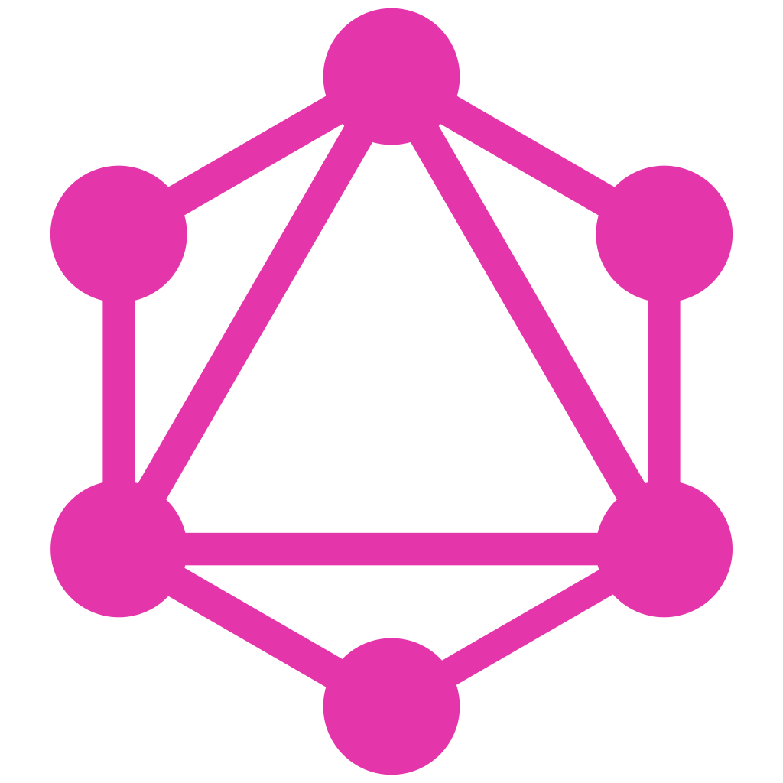
GraphQL 101
by R. Apú
June, 2023

Slide 2
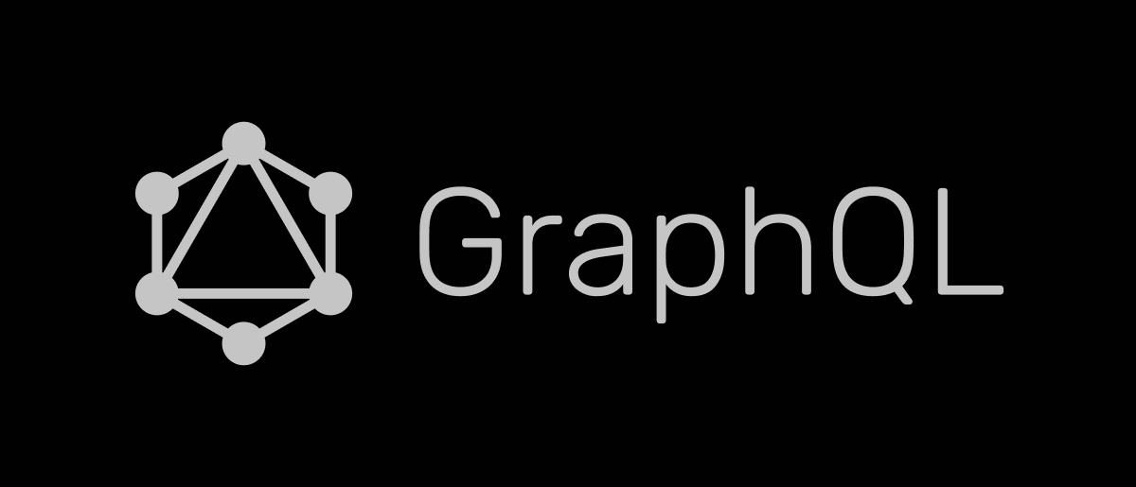
1
What?
2
Why?
GraphQL vs REST
3
How?
Architecture Examples

Slide 3
What is GraphQL?
?
Gorilla Logic Proprietary and Confidential

Slide 4
“a query language and execution engine originally created at Facebook in 2012 for describing the capabilities and requirements of data models for client-server applications.”
GraphQL Spec ( October, 2021)

Slide 5
GraphQL is…
GraphQL isn’ t…
… a standard of a language to communicate between clients and servers.
… self documented once an engine is deployed
… data source agnostic
… used in gateways in microservices archs.
… declarative
… used for both queries and data manipulation
…a programming language
… a relational database management language like SQL.
… implemented in a central repository.

Slide 6
Why use GraphQL?
?
Gorilla Logic Proprietary and Confidential

Slide 7
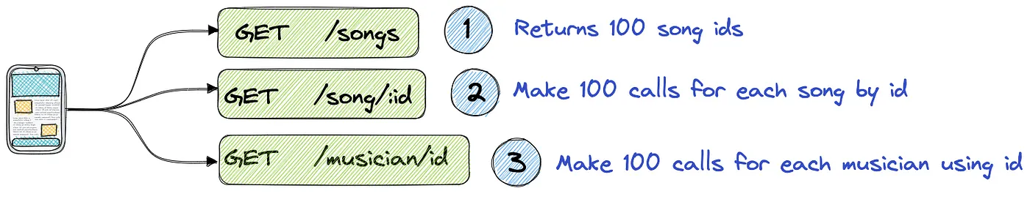
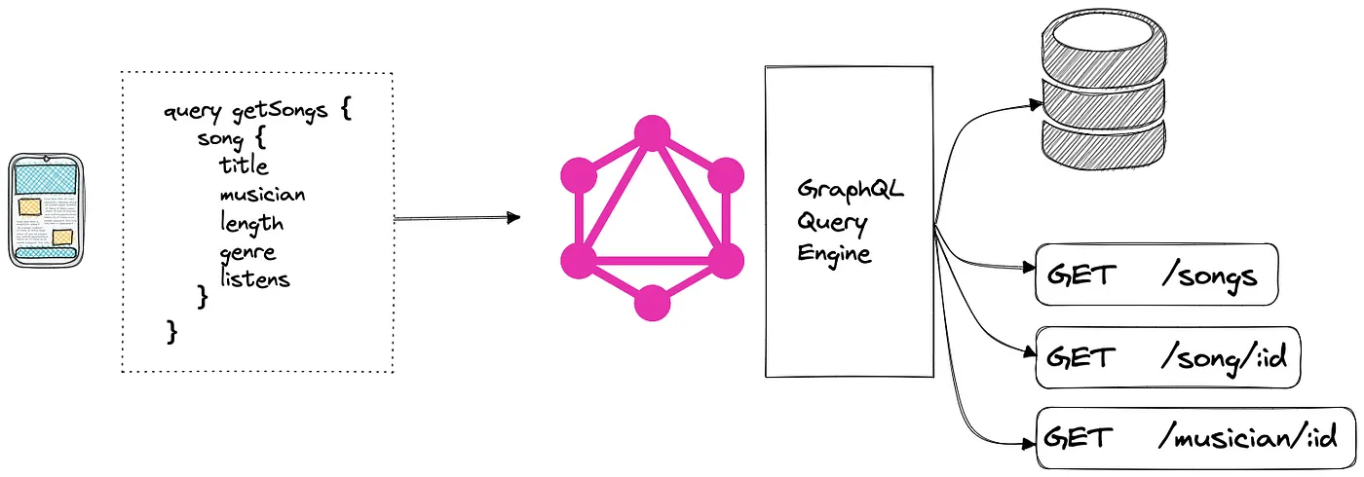
Catered Queries
5.73 in 10 in

Slide 8
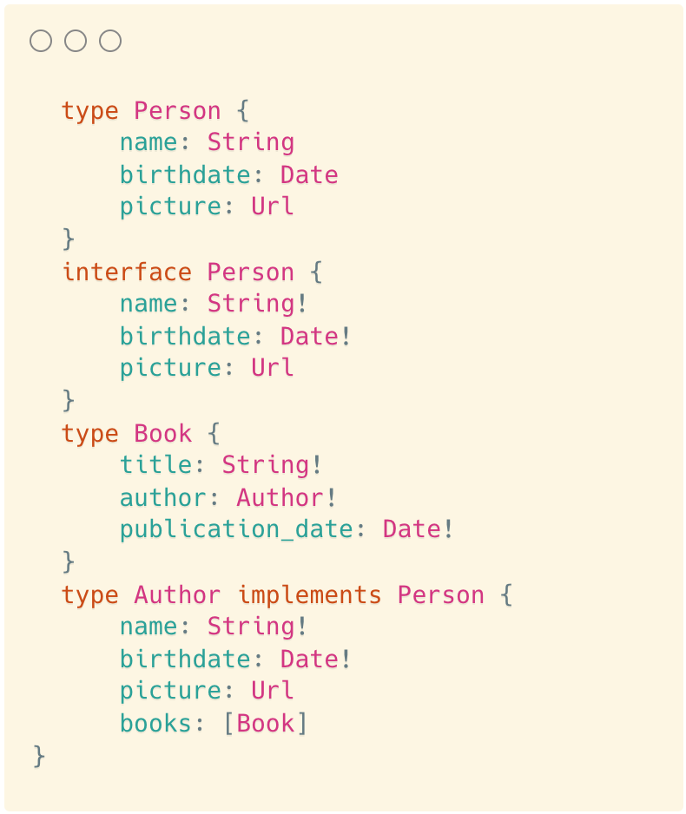
2. Strongly typed schemas
Language specifies:
types,
interfaces,
unions,
enums,
field arguments,
polymorphism,
fragments

Slide 9
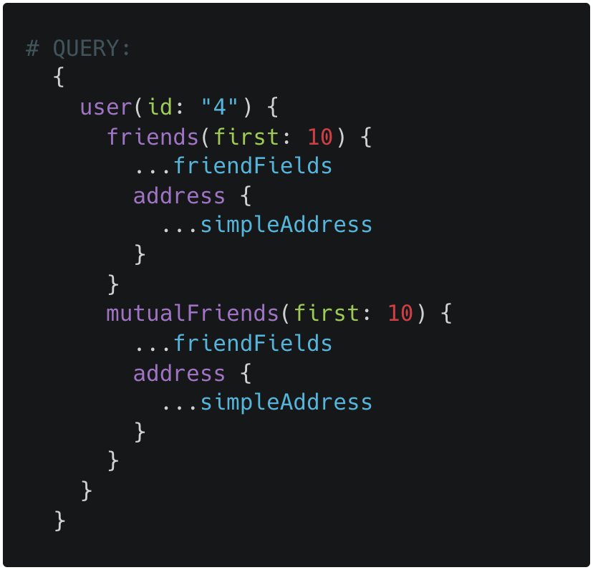
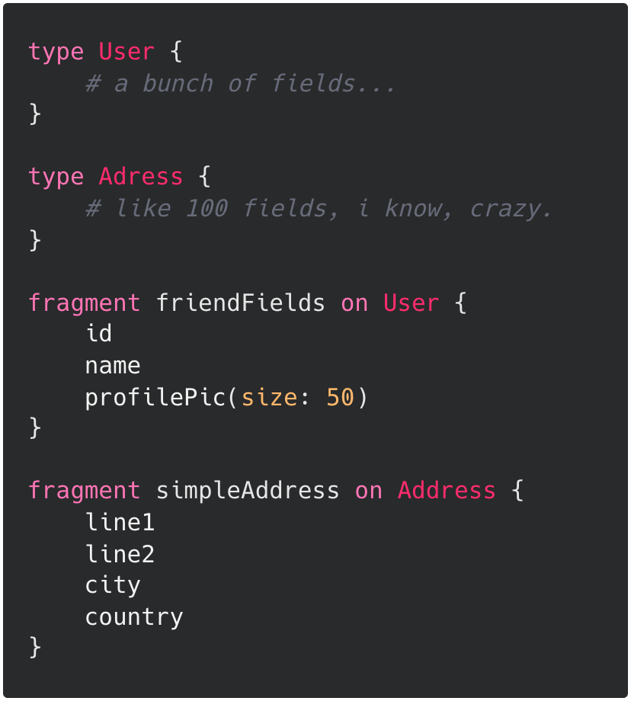
3. Composition tools: Fragments

Slide 10
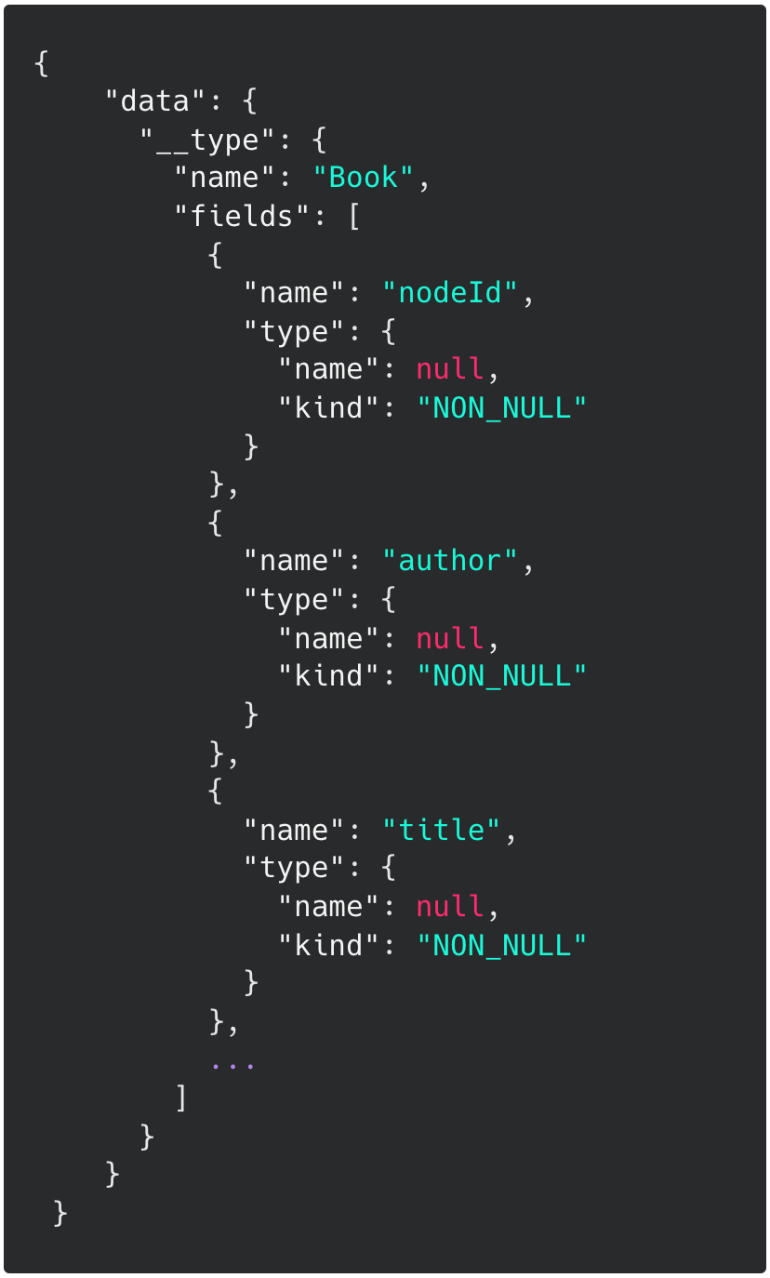
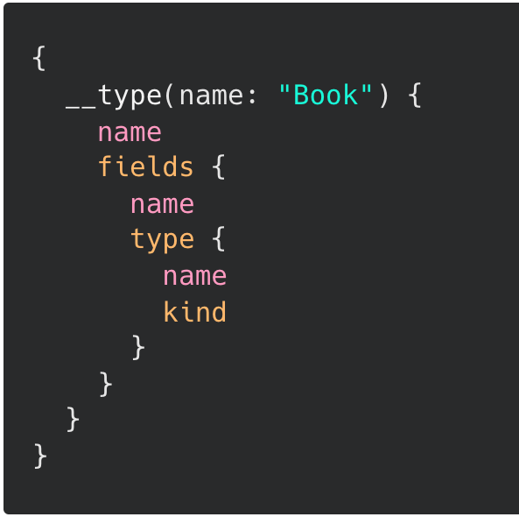
4. Self documented through introspection

Slide 11
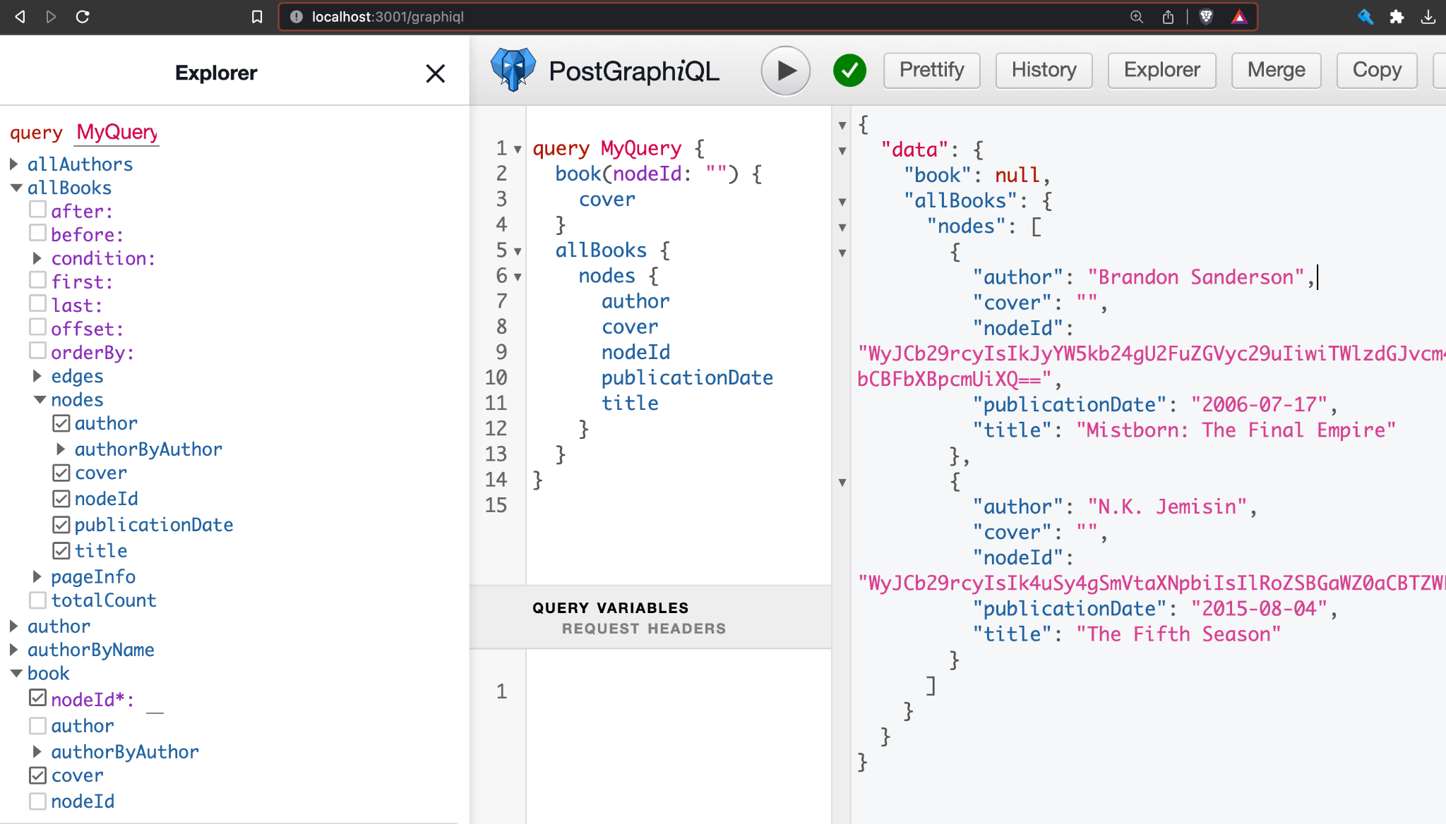

Slide 12
How does GraphQL Work?
?
Gorilla Logic Proprietary and Confidential

Slide 13
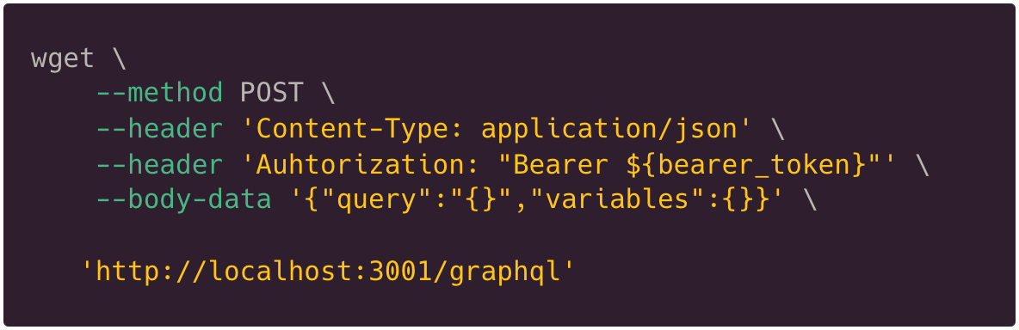
It’s just a POST http request!
Auth in Headers
JSON Body is Operation (query, mutation, subscription)
Variable support

Slide 14
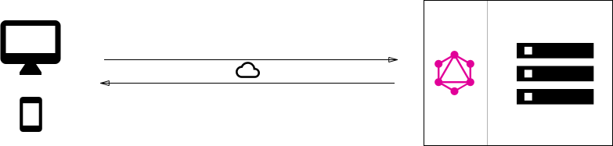
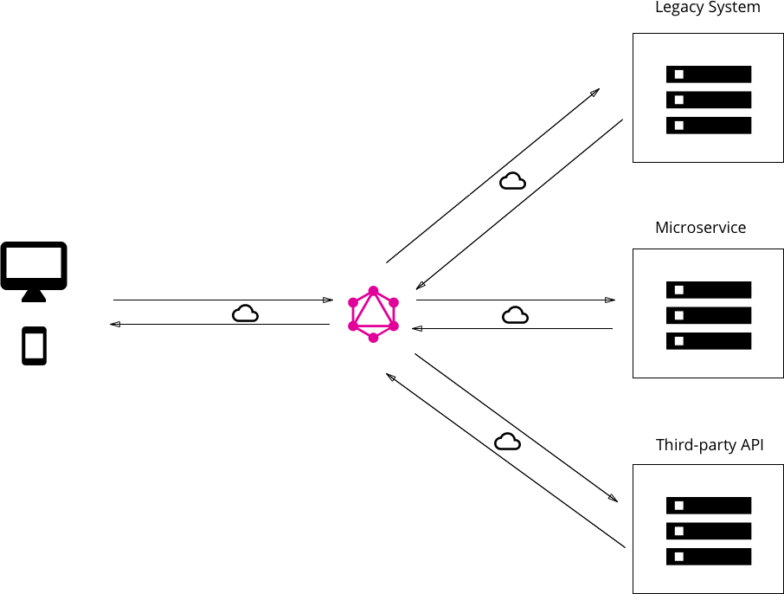
Architecture examples (1, 2)
Embedded alongside the db engine and data.
Standalone gateway
Hybrid of 1 and 2
Analog of 3.
BFF
Authentication is important

Slide 15
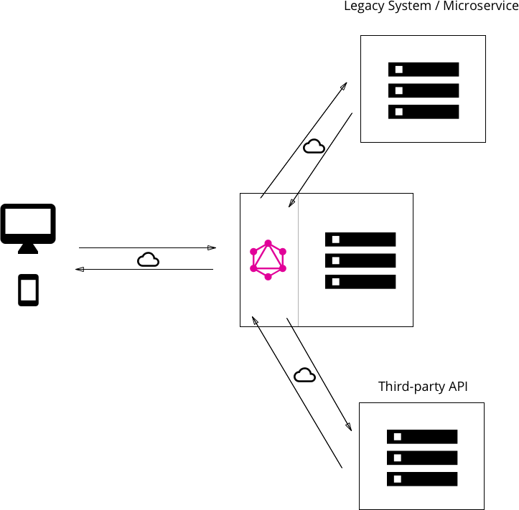
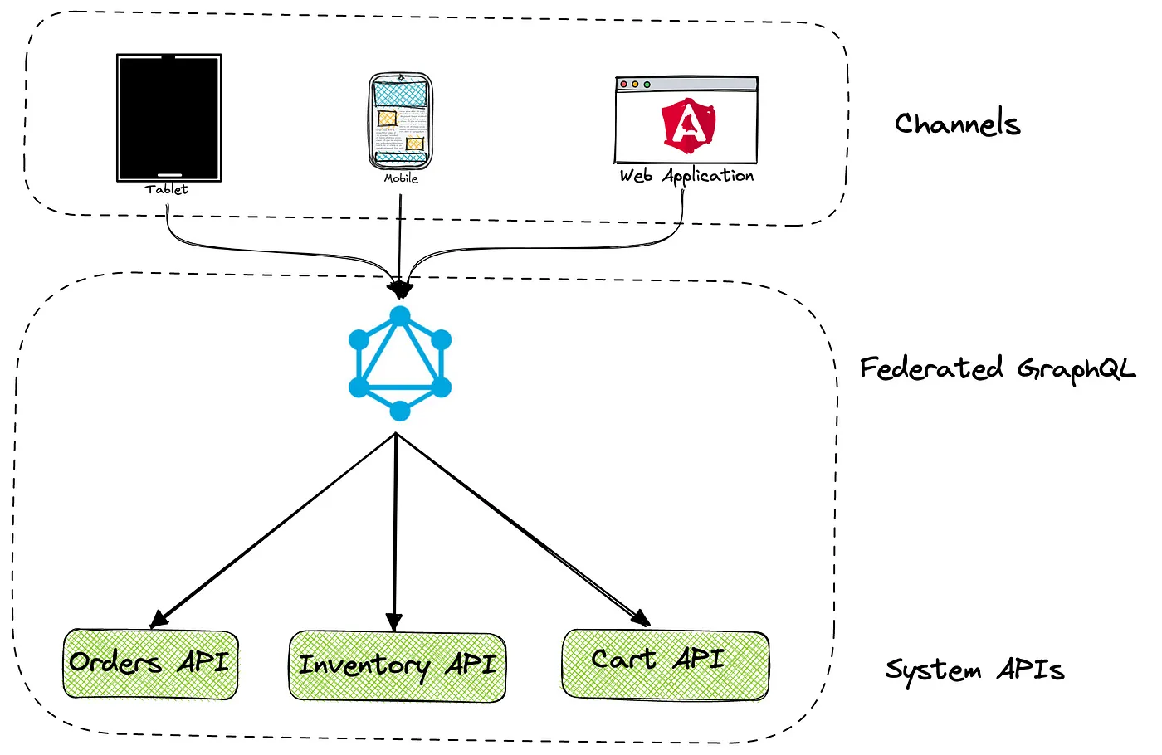
Architecture examples (3, 4)

Slide 16
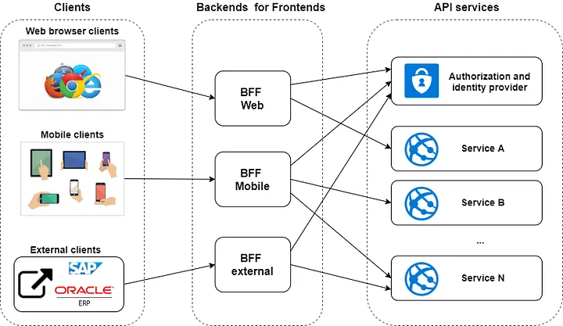
Architecture examples (5)

Slide 17
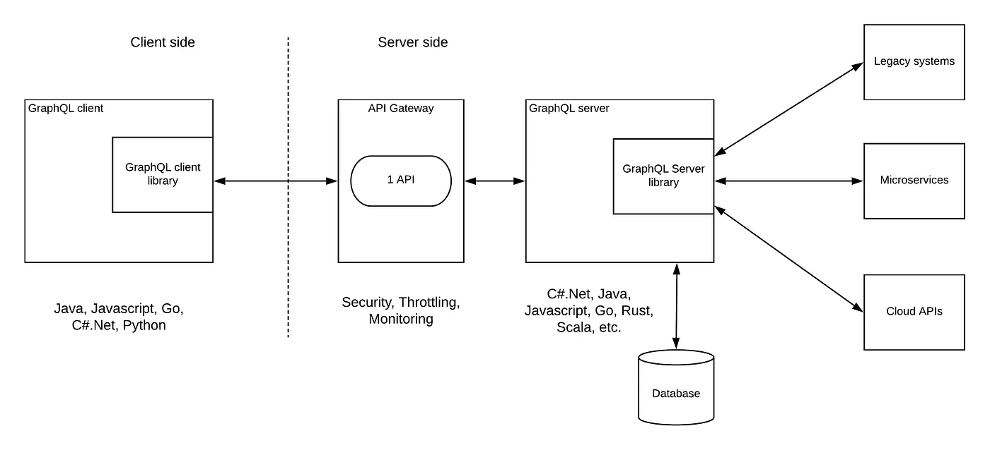
Architecture examples (6)
Bearer Token:
OAuth 2.0 w custom auth
OAuth 2.0 w Identity Provider
JWT
Basic Auth
…

Slide 18
BONUS: Schema Stitching
BO
Gorilla Logic Proprietary and Confidential

Slide 19
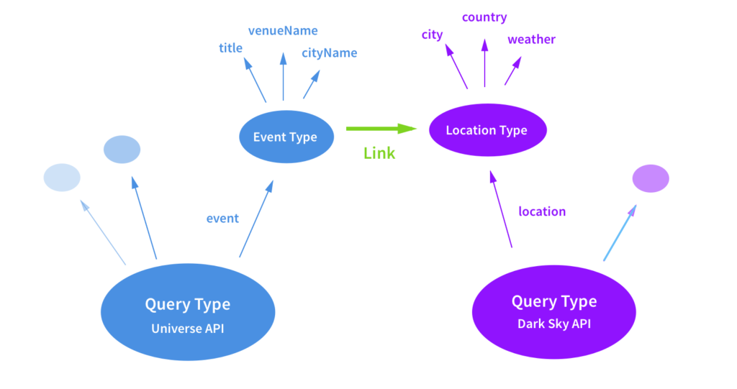
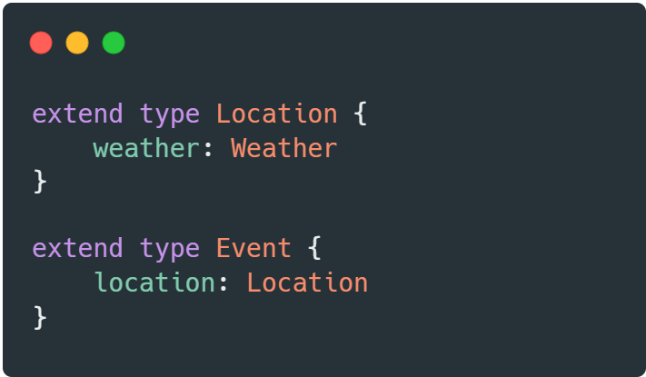
Schema stitching (cont.)
Related models in different APIs can be linked in a server environment to save resources in client machines
graphql-tools by The Guild

Slide 20
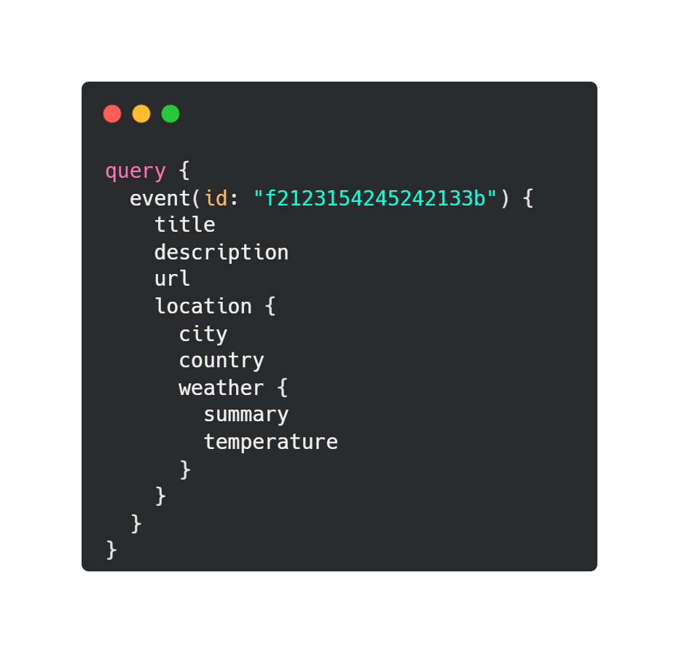
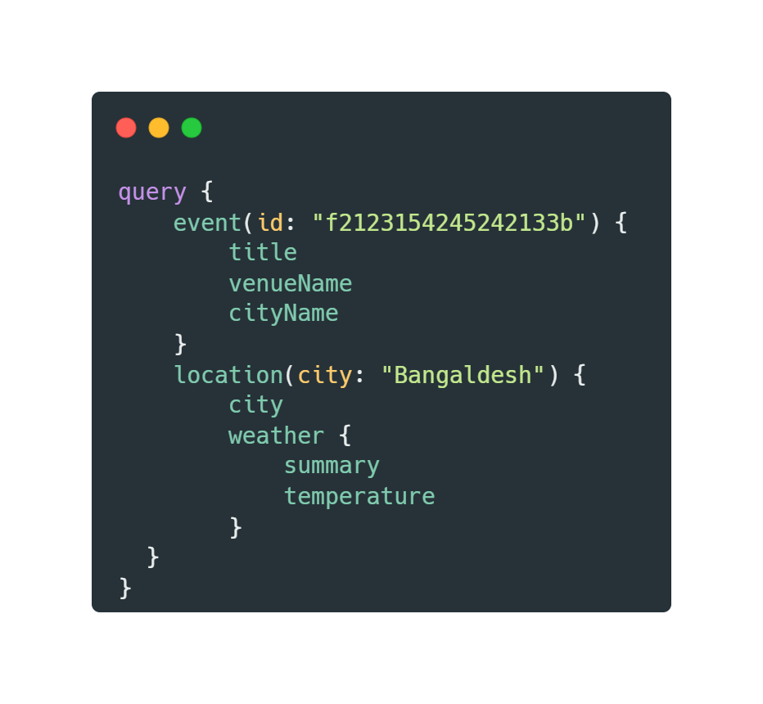
Schema stitching (cont.)
Related models in different APIs can be linked in a server environment to save resources in client machines
graphql-tools by The Guild

Slide 21
Recap
GraphQL puts the client perspective first
Not a Language, a Standard
Abstract BE away at your own risk
HTTPS FTW
Catered queries are good
Auth is Important

Slide 22
the end.
Additional Resources:
Research Notes
Demo Repository

